Slide 1
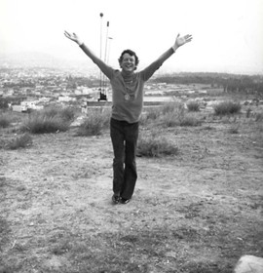
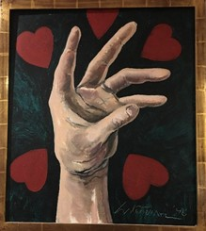
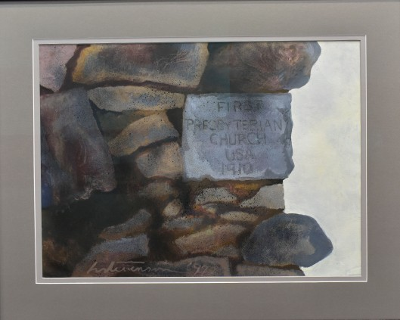
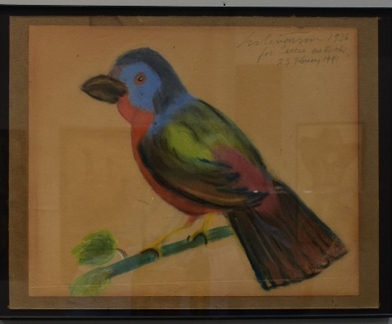
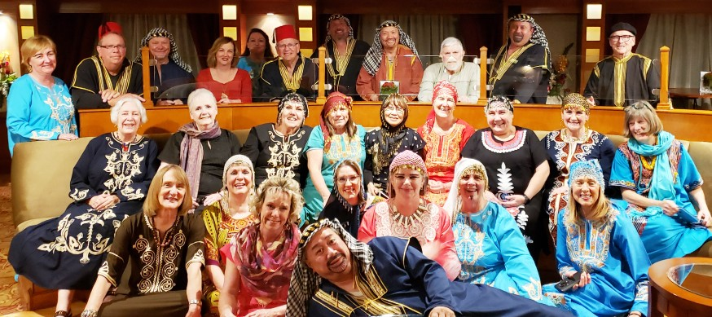
Sherds
April - June 2020
“Whatever you do, do it well”~ Walt Disney
ART IN COMMUNITY:
The Harold Stevenson Collections
Through August 23, 2020
Harold Stevenson(1929-2018) was an internationally recognized artist from Idabel Oklahoma. Many labels have been applied to Stevenson’s art: Pop art, avant-garde, surrealism, nouveaux realism, necromantic, odalisque, large-scale, anatomy, male nudes, erotica, modern, contemporary, and expressionism. They are all partly correct. Stevenson went beyond the canvas as an artist. He created a sizable collection of glass sculptures in Murano Italy, a self-portrait bronze bust, and he made furniture. He was famous for his giantism and greater than life-sized body parts. Stevenson, “a talented student” was excluded from a 1947 national art competitiion because he failed to adhere to the size guidelines. Understanding Harold Stevenson’s art begins with understanding the infuences, inspirations emotions, cultures, and values that resonated for him. He painted prolifically
for eighty years. Stevenson lived away from Idabel for most of his adult life, but returned often to visit.
The majority of works featured in this exhibit are borrowed from family members, friends, and neighbors from the four states area around Idabel and McCurtain County, Oklahoma.
Dr. Dian Jordan, a sociologist from the University of Texas of the Permian Basin, served as visiting curator. She is Stevenson’s biographer, working closely with the family.
Harold Stevenson, Athens Greece, 1986
Painted Bunting, 1936, Loan, Courtesy of Caccie Stevenson Leonard
Solitaire Hand, 1998, Loan, Courtesy of David and Rebecca Stroud
Presbyterian Church Cornerstone, Garvin OK, 1997, Loan, Courtesy of First
In this Issue;
Directions and People.................Page 1
Calendar of Events......................Page 2 Current and Upcoming Exhibits...Page 3 Gifts and Support ........................Page 7
Recent Acquisitions.....................Page 8
Friends of the Museum take a study tour of Egypt in February.

Slide 2
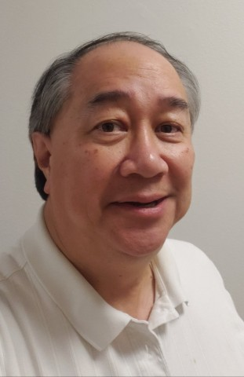
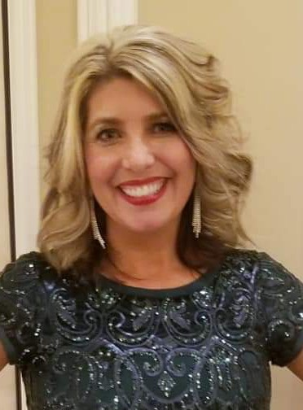
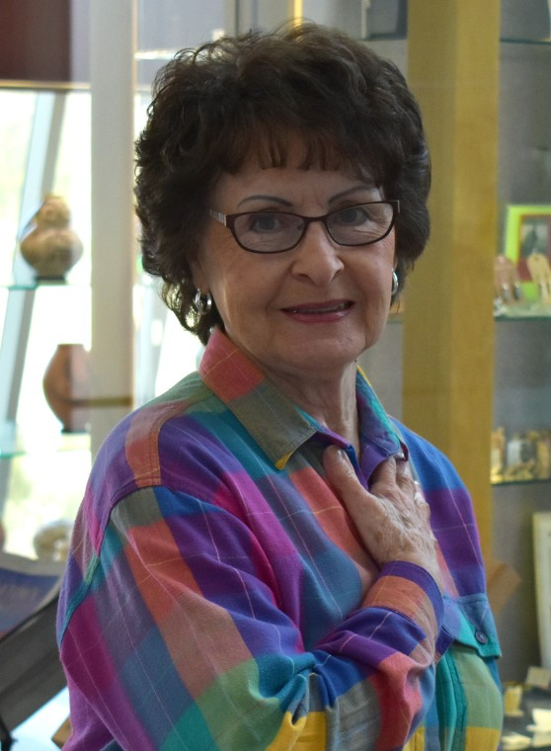
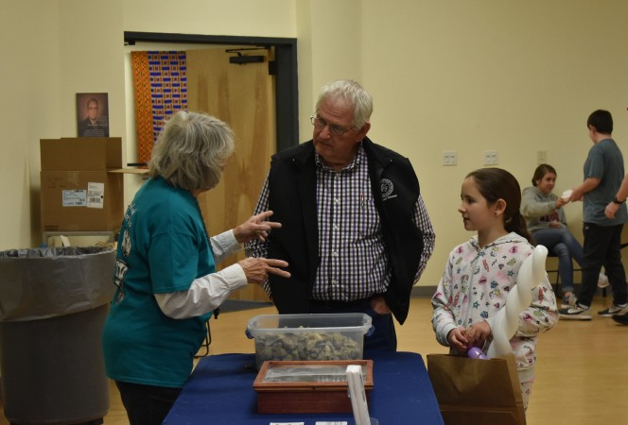
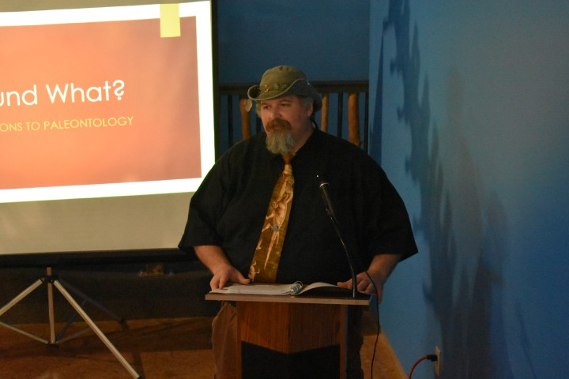
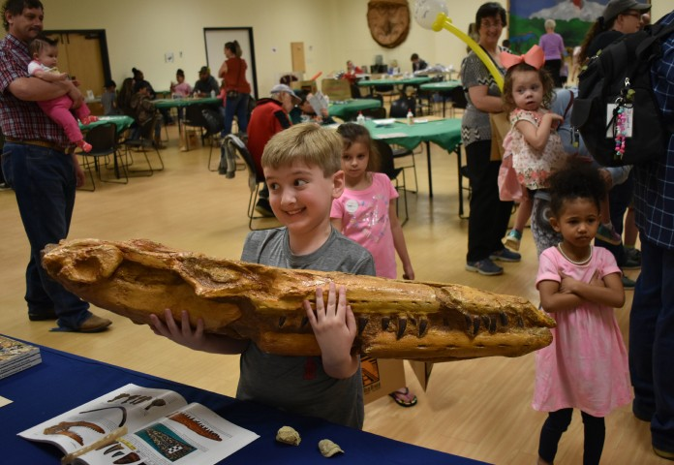
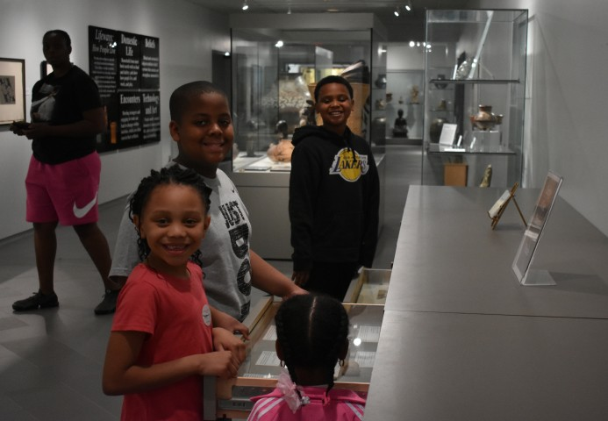
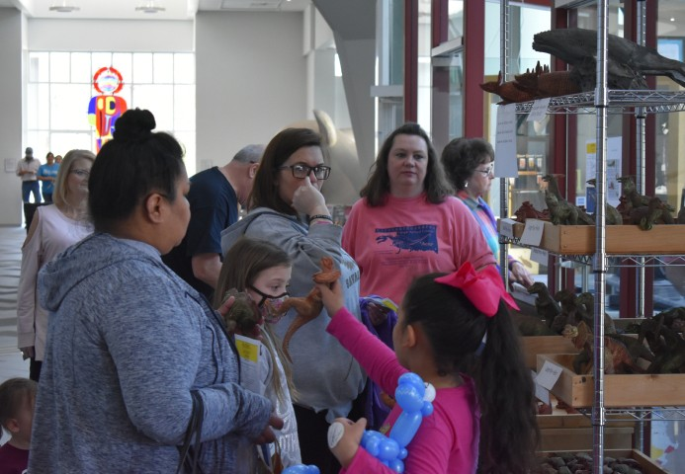
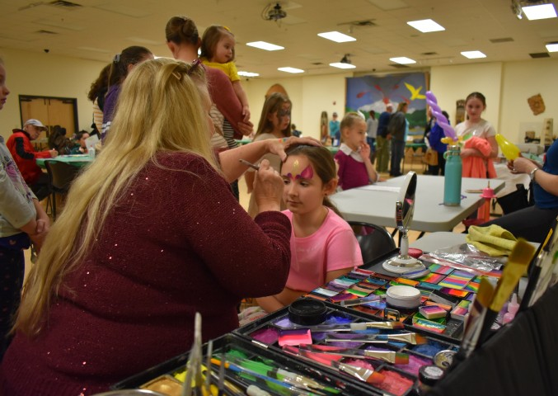
1
Directions
Due to SHERDS being a quarterly publication, we struggle to make it timely announcing future programs while highlighting past events. This issue was produced during a time the Museum is closed to the public due to the global pandemic. The decision to close came March 19, following the passage of City of Idabel Mayoral Resolution 2020-1, which included “social-distancing” and limiting the size of public gatherings.
We have cancelled several programs scheduled for the near future. Staff remain busy, responding to inquiries received by telephone, the mail and social media. We are also catching-up with office work, mostly from home,
while brainstorming new ideas. We look forward to serving the public again soon, and hope you’ll stay healthy and enjoy all the happiness you can.
Henry Moy
People
Mrs. Leigh Jackson is the recipient of the 2020 Ernest R. “Jack” Tucker Award for Community Service. She is being recognized for years of volunteer work with local Relay for Life events (American Cancer Society), community clean-up programs, and the local Special Olympics.
Joining the Museum staff is Glenna Minter as receptionist and store attendant.
Museum attendance continues to show impressive growth with both casual visitors and organized school groups. Feb- ruary attendance was double last February’s, and attendance through mid-March was greater than all of March last year.
Additionally, in the first quarter (of 2 ½ months), over 400
school children were served, with other visitors from
17 states and 3 foreign countries.
Leigh Jackson
Glenna Minter
Recent Events
The Museum had a large attendance for Acrofest 2020 on March 7. Joseph O’Neil with the Dallas Paleontological Society lectured, while Kyle Davies of the Sam Noble Oklahoma Museum of Natural History talked about “Why is there Acrocanthosaurus in McCurtain County.” Also former State Archaeologist Bob Brooks and Carolynn Neal
Mike Crain discusses fossils.
were on site to identify artifacts.
Joseph O’Neil lecturing in the Acro Gallery.
The Dallas Paleontological Society displays casts of fossils.
A family admiring artifacts in the Gregory Visitors gather in the Don and Mary
S. Perino Archaeological Study Area. Etta Herron Reception Hall.
Children enjoying face painting during Acrofest 2020.

Slide 3
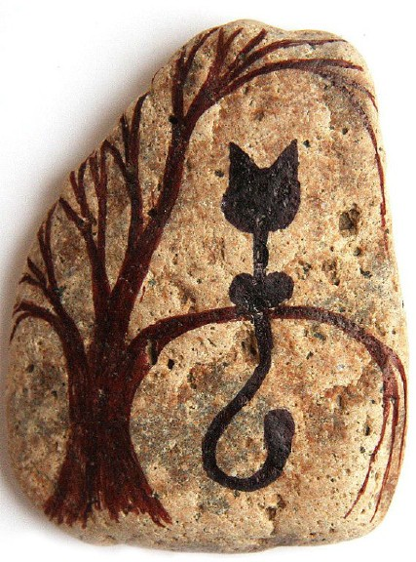
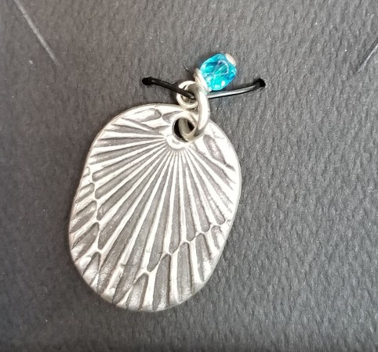
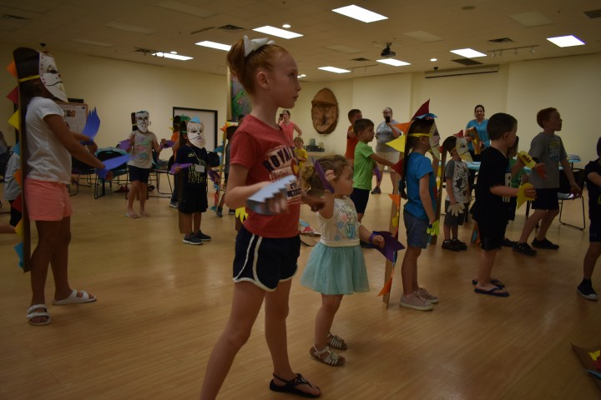
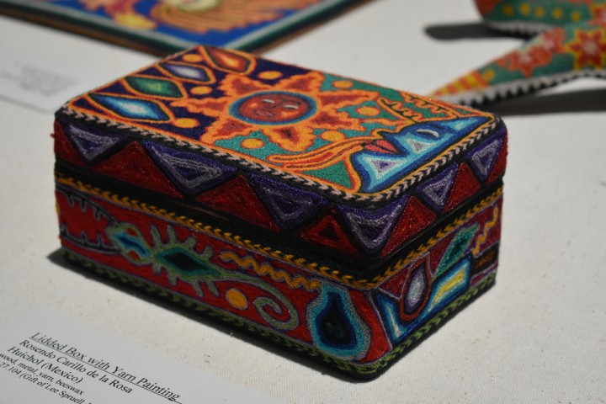
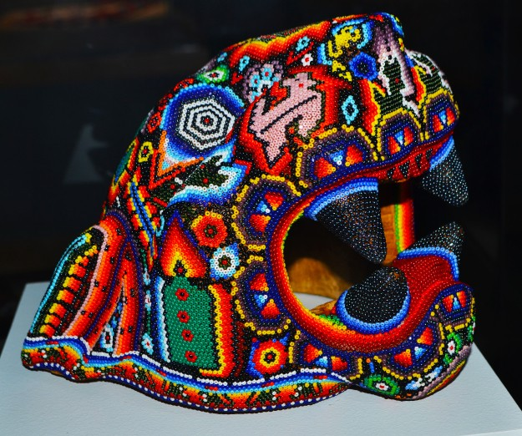
2
Calendar of Events (April - July 2020)
With the current shut-down, we are unable to confirm any schedule through May, 2020.
June 6
10am-3pm
Fun with Rock Art - Participants will use ink and paint on rocks to create figures.
This is a come and go class. Free event!
Sponsors: Arvest (Bank) Foundation, The Ann Armstrong Fund, The Jack and Linda Bell Educa- tion Fund
June 22-26 9am-3pm
Summer Explorers Camp: Imperial China- This year, budding anthropologists ages 8 to 12 will learn about the culture of Imperial China, including the arts, food, religion, and people through hands on activities. Attendees must bring a sack lunch. Fee of
$100
Sponsors: Arvest (Bank) Foundation, The Ann Armstrong Programs Fund,
The Jack and Linda Bell Education Fund (TCF), The Mark Aviyonah and Shera Aviyonah Scholarship fund
June 27
12:30pm - 4:30pm
Silver Metal Clay JewelryWorkshop - Beginner Level - Join Brenda Johnson as she leads a beginners jewelry making class. Participants will have the opportunity to create several pieces of handmade jewelry using silver metal clay. Cost for the class is $70 and includes all material and the use of tools. Participants must be at least 16 years old.
Necklace pendant by
Brenda Johnson
July 6-8 Session I July 13-15 Session II
9am-12pm
Dino Camp: Acro & Friends - Kids ages 4-8 are invited to participate in the Mu- seum’s annual Dino Camp. Please note: To meet demand there will be two Dino Camps. This years theme is Acro & Friends. Campers will be able to learn all about McCurtain County’s resident dino Acrocanthosaurus, and other dinosaurs that lived during its time. Participation fee $50
Sponsors: Arvest (Bank) Foundation, The Ann Armstrong Programs Fund, The Jack and Linda Bell Education Fund (TCF), The Mark Aviyonah and Shera Aviyonah Scholarship fund
July 11
10am-3pm
Fun with Huichol Bead Art- Participants will use small pieces of wood to ap- ply beads to beeswax. Beads, among other materials such as yarn and wood, are highly utilized in the extremely creative and imaginative art of the Huichol people of west Mexico. They use tiny beads pressed into sun warmed bees- wax to decorate their masks, bowls, and animal figures. Free event!
Sponsors: Arvest (Bank) Foundation, The Ann Armstrong Fund, The Jack and Linda Bell Education Fund
Lidded Box with Yarn Painting, Rosendo Carillo de la Rosa,Huichol (Mexico), Gift of Lee Spruell
Beaded Jaguar Head, Huichol (Mexi- co) ca. 2004,

Slide 4
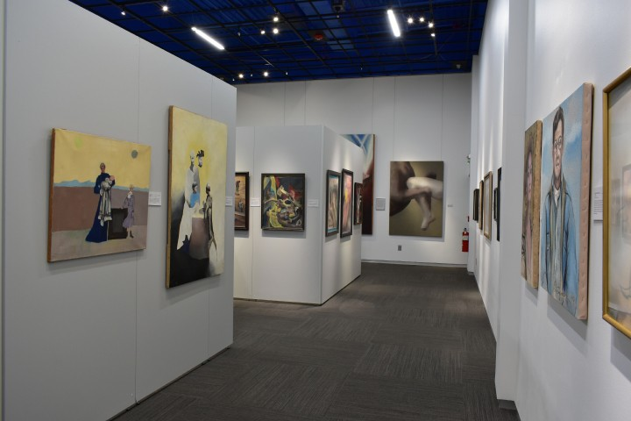
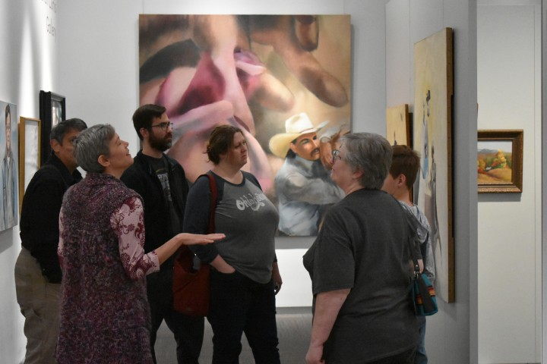
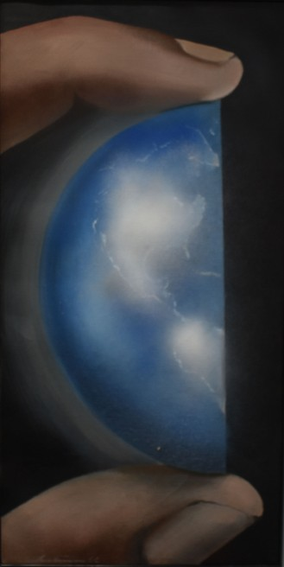
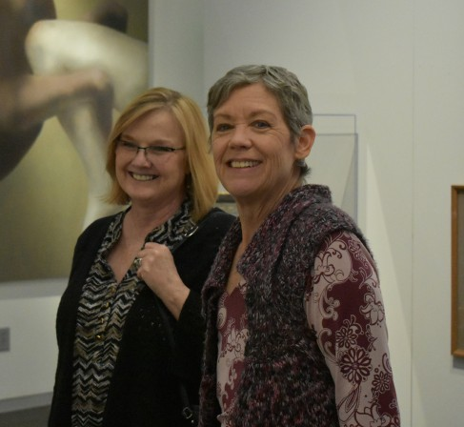
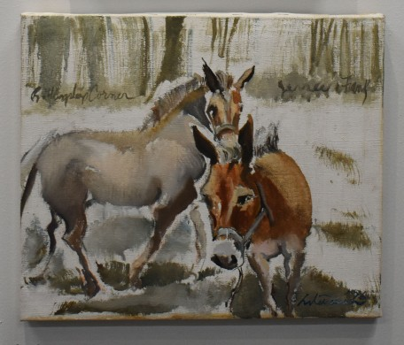
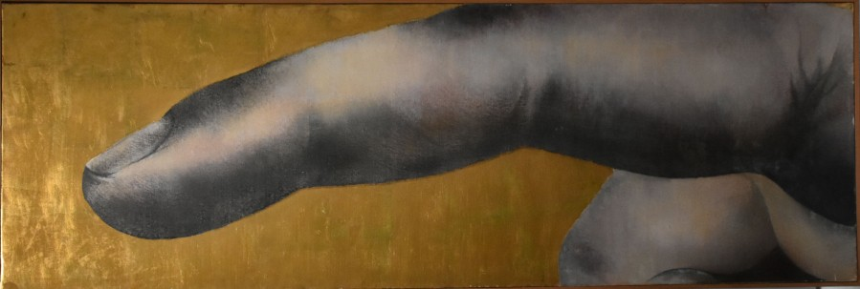
3
Current and Upcoming Exhibits
Mary Bratton Curtis Gallery
Art In Community: The Harold Stevenson Collections (extended through August 23)
Stevenson (1929 - 2018) is among the most important Idabel natives whose contributions to modern art earned him international renown. His skills were recognized at an early age, and he studied at New York’s Art Students League with the likes of Alexander Calder and Andy Warhol. He quickly became a fixture of the New York and world art scene. This exhibit focuses on his contributions to the community and includes over fifty (50) works held by individuals, families,
and institutions with connections to the immediate area. It is organized by Stevenson’s biographer, Dr. Dian Jordan (University of Texas of the Permian Basin) serving as visiting curator.
Dr. Dian Jordan with the visiting Fuller family.
God Holds the World, 1966, Loan, Courtesy of Helen Rose Arnet Mann and Family
Dr. Dian Jordan and lender Toni Wray.
Jesse and Frank, 1996, Loan, Courtesy of Clay and Stephanie (Stevenson) Coldiron
Nathaniel and Lana Grey Gallery
(in the Mary H. Herron Community Conference Center)
Mapping the World (May 19 – September 20)
Finger of God, 1962, Loan, Courtesy of Oklahoma City Museum of Art
Maps dating from the 17th through 20th centuries, highlighting new discoveries, fantastic assumptions, and historical information that changed as explorers and mapmakers learned more about the world around them; includes loans from Mabee-Gerrer Museum of Art.

Slide 5
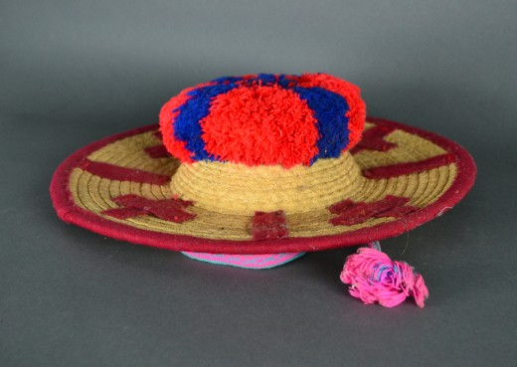
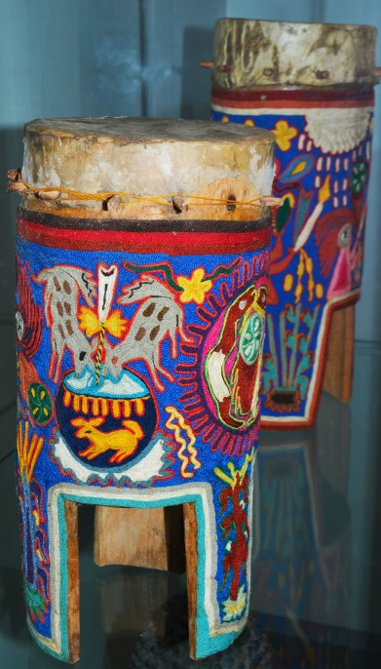
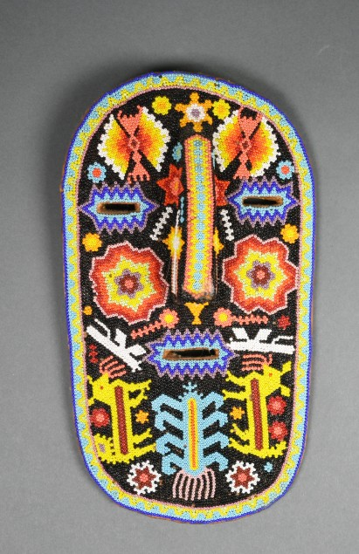
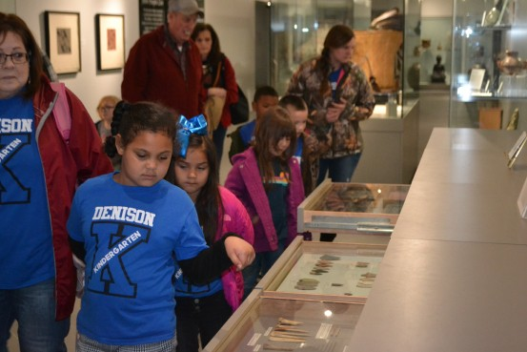
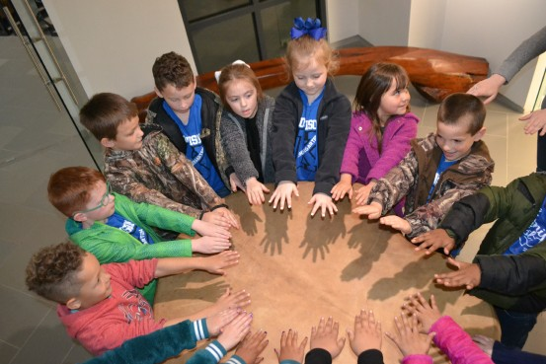
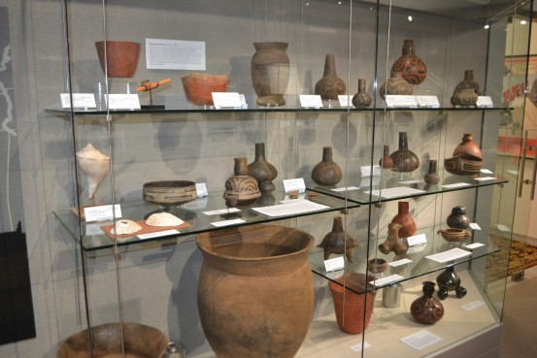
4
Current and Upcoming Exhibits (through July) continued
Los Huicholes (June 16 – September 6; exhibit continues in the Jack Bell Hall)
The Huichol peoples of west Mexico are known for their colorful beading and “yarnpainting” crafts. Featured in this exhibit will be objects from Lee Spruell, who has worked among the Huichol as a “missionary educator” for nearly fifty years. He recently gifted his personal collection to the Museum while preparing for a permanent move to Mexico.
Hat, ca 1990, Huichol (Mexico); Gift of Lee Spruell, (LA)
Drums (2) with Yarn Painting, ca 1990, Rosendo Carillo de la Rosa, Huichol (Mexico); Gift of Lee Spruell, (LA)
Lifeways Gallery
Objects from the Museum’s collections are used to illustrate the ethnological themes of Domestic Life, Beliefs,
Encounters, and Technology and Art. The gallery houses the Gregory
S. Perino Archaeological Study Area where collections of regional archaeological material are available for research and appreciation.
It honors the work of Gregory S. Perino (1914 - 2005), archaeologist and the Museum’s first director (1975 - 1984). The new Recent Acquisitions area is also located here, and for the next decade will honor the ongoing generosity to the collections of Dr. Richard and
Nancy Weiss.
Beaded Mask, ca 1990, Rosendo Carillo de la Rosa, Huichol (Mexico); Gift of Lee Spruell, (LA)
Students from Denison School take a field trip to the Museum.
“Pow wow” style drum made from a cottonwood tree trunk, and Bison hide is a popular display for children.
Gregory H. Perino Archaeological Study Area houses many Native Ameri-
can artifacts.

Slide 6
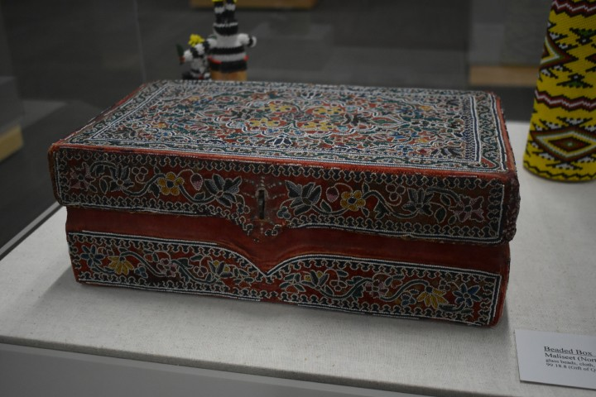
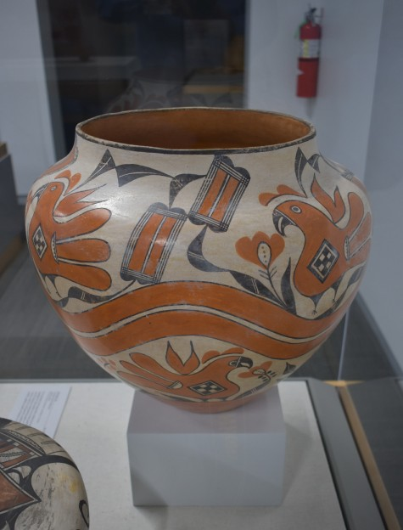
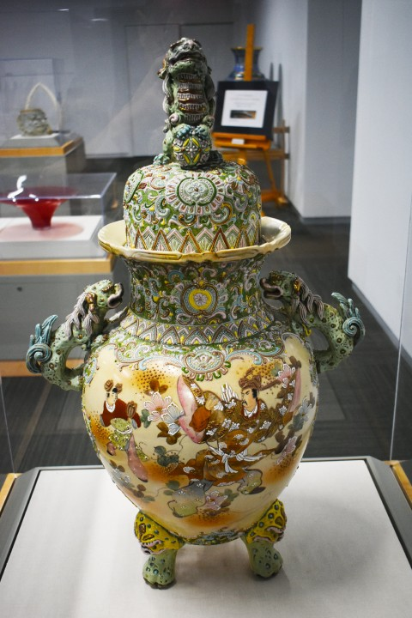
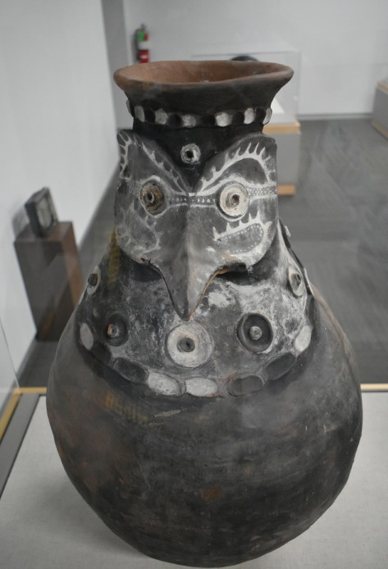
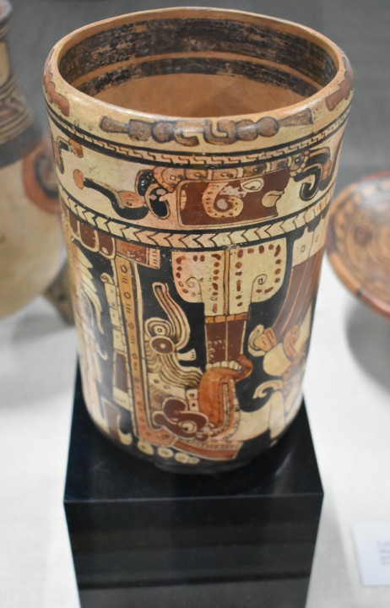
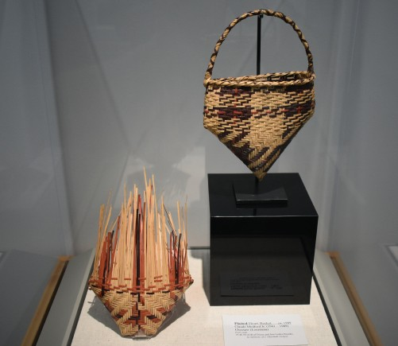
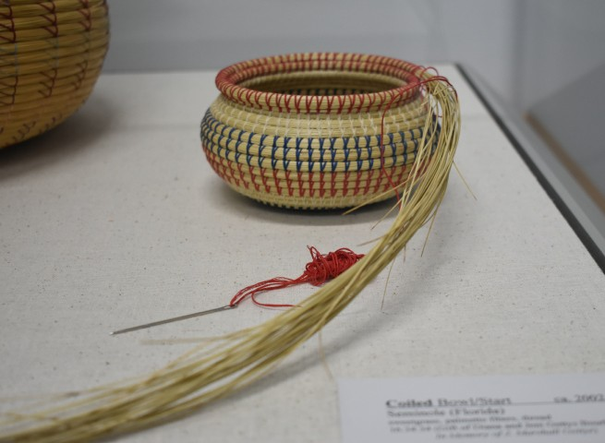
5
Current and Upcoming Exhibits (through July) continued
Founders Gallery
Inspired by Museum founders Quintus and Mary Herron, this exhibit space celebrates the Museum’s permanent collections, highlighting some of the finest examples of material culture from all over the world available for public appreciation.
Storage Jar, ca. 1910, Acoma
(New Mexico), Gift of
Quintus H. and Mary H. Herron
Beaded Box, ca. 1870, Maliseet,
(American Northeast), Gift of Quintus H. and Mary H. Herron
Covered Jar, ca.1890, Satsuma Style (Japan); Gift of Nathaniel and Lana Grey (IL)
Damarau (Sago Flour Storage Jar), ca. 1990, Aibom Village, East Sepik Province, (Papua New Guinea), Gift of Dr. David and Karina Rilling (PA)
Cylinder Jar, ca. 450-800,
Maya (Honduras), Gift of Quintus H. and Mary H. Herron
J. Marshall and Sally Gettys Family Gallery
Focused on native technology in the creation of art, this intimate exhibit space honors the work of the late J. Marshall Gettys, and acknowledges the continuing generosity of his wife Sally Gettys, their extended family, and friends.
Unfinished Coiled Bowl, ca 2002, Seminole (Florida) Gifts of Dian and Jeni Gettys Bourke, In Mem- ory of J Marshall Gettys)
Plaited Heart Basket, ca1989, Plaited Bull-Nose Basket/ Start, ca 1985 Claude Medford Jr.,
(1941-1989), Choctaw, Gifts of Dian and Jeni Gettys- Bourke, In Memory of J
Marshall Gettys (OK)

Slide 7
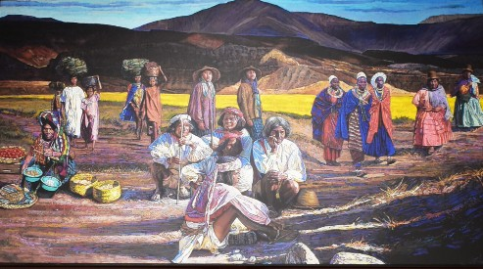
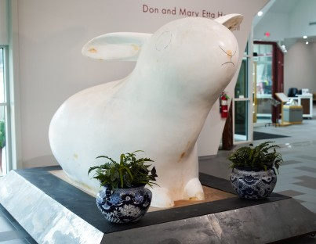
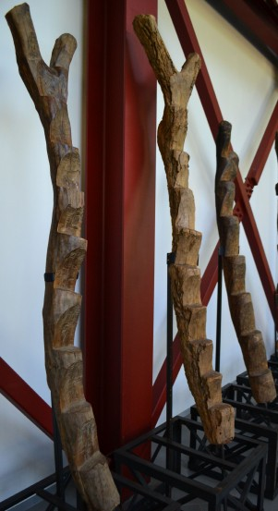
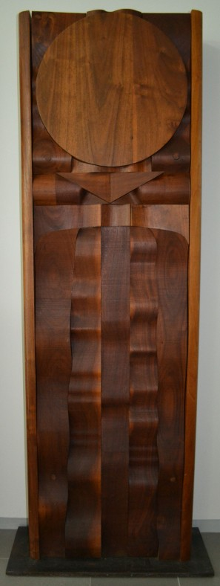
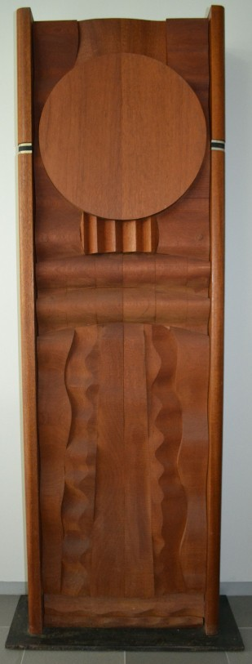
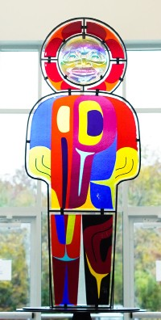
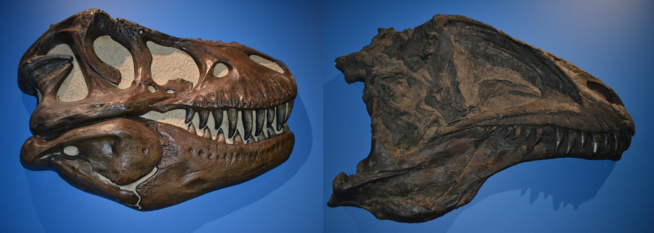
6
Don and Mary Etta Herron Reception Hall
The main reception area at the front entrance to the Museum, this hall honors the generosity of Don and Mary Etta Herron. It houses the glass and steel sculpture Raven Kachina by the late Quinault/Isleta Pueblo artist Marvin Oliver (1946 -2019), the “rabbit sculpture” elizabeth by Ft. Worth artist Chris Powell (b. 1957), and an untitled multimedia piece by Robert Rivera
(b. 1950). Additionally, four wood works by sculptor James Strickland
(b. 1945), created during his time as visiting faculty/artist in residence at the University of Oklahoma in the late
1970’s, and the large mural Coming to Oklahoma, created in 2017 by pastel
artist Bill Baker (b. 1961) are installed. Large ethnographic wood carvings from the Nupe and Dogon peoples of west Africa and the Iatmul peoples of New Guinea round out the artworks on view.
They Are Coming To Oklahoma, 2018, Bill Baker (American, b. 1961)
elizabeth, by Chris Powell, (American, b. 1960)
Raven Kachina (2003,
2019) Marvin Oliver (Quinalt/Isleta1946-2019)
Kachina Totem, and Kachina Totem III, James Strickland, (American, b. 1945), Gift of Ben Pickard (OK)
Ladders, Dogon Peoples, Bandi- agara escarpment region of Mali and Burkina Faso; Gift of Ben Pickard (OK) and Dr. David and Karina Rilling (PA)
Ed and Cindy Fulmer Dino Den
Attached to the gallery housing the cast skeleton of Acrocanthosaurus atokensis, this exhibit space provides interpretive materials placing Acro in context with other dinosaurs of the Mesozoic Era. The official State Dinosaur of Oklahoma, Acro lived during the early Cretaceous period, about 110 – 125 million years ago. The original fossil of the McCurtain County specimen was the most complete one ever recovered, and provided paleontologists new information on this “top” predator of its time. The “Den” honors the generosity of the Ed and Cindy Fulmer family.
Casts of the skulls of Tyrannosaurus rex and Acrocanthosaurus are displayed in this area for comparison.

Slide 8
7
Gifts and Support
(Names in bold are of donors whose gifts were received in the most recent quarter)
Grants
Herron Foundation, Inc., International Paper Foundation,
Membership
(General Support, plus donors (individual and family) to other Museum funds, who are provided membership benefits at
equivalent levels; active after 1 January, 2020)
Directors Circle: Bob Baker, Eric and Mark Beasley, Michael and Jeanne Bernstein, Victoria Craig, Michael Cutchall, Bruce and Cheryl Delp, C. Kendric Fergeson, Ed and Cindy Fulmer, Sally Gettys, Ed Harris,
Don and Mary Etta Herron, Janet Herron and Gamaliel Leyva, R.Q. Pete and Katie Herron, Buck and Natalie Hill, Dr. Frederick W. Lange, Kama and Greg Koontz, Larry Lambert, Dr. Ronald and Maxine Linde, Dr. Ernesto and Luisa Lira, David Model, Henry Moy, James and Tobin Newcomb, Judy and Bob Petre, Ben Pickard,
Dr Daniel Rifkin, Julia and Forrest Sewell, Don and Nelda Shaw, Taylor and Becky Shaw, John and Barty Shipp,
Ronny and Doris Smithee, Cheryln Townsend, Michelle and Terry Walker, R. Weiss, Ron and Lynne Wetherell
Curatorial Circle: Dr. Gretchen Adams and Brad Morse, Dr. Robert and Pamela Brooks, Ken and Dixie Busby, Lindsey Campbell, Mike and Linda DeBerry, Carl and Sue LeForce, Michael and Lana McElroy, Carolynn Neal,
Bob and Robin Terry, Dian Jordan Werhane, Carolyn and Eddie White, Hank Farley, Bill Gentry, John and Sue Hinkel, Jane Riggs, Brian and Lisa Shipp, Ron and Doris Smithee, Billie Tomlinson, Mike and Cindy Williams
Contributors: Jeanette and Gregory Bohanan, Presley Byington, Dr. Ken Carpenter and Yvonne Wilson,
Vic and Karla Clay, Ambia and Mike Crain, Chuck and Jan Darby, Ken and Debbie Farley, Jane and Tom Harding, Kyle and Katie Jones, Doris Perkins, Javier and Irma Reto-Viteri, Mike and Anita Stevenson, Bill and Sharon White, Dr. Glenny and Charles Beach, Jimmy Dale Billy, John and Sheila Dewitt, Tom Ellis, Fred Fagan, Walt and Melinda Frey, Marjorie Bardeen and Dr. Robert Gethner, Pattie James, Cindy Kennedy, Mayumi and Steven Kiefer, John and
Patricia Malin, Jack Moy, Dane and Lynn Pollei, Lewis and Karla Schwartz, Larry and Jennifer Shaffer
Associates: Marjorie Bardeen, Greg and Jeanette Bohanan, Dr. Chester and George Ann Danehower, James and Trudy Childers, Johnnie Clinton, Linda and Chester Cowan, Rev. Charles and Jan Darby, Jim and Christine Eastep, Daniel W. Eck, Ron and Carolyn Engel-Wilson, Dolphus and Robbie Farley, Mary Duffy Farrell, Brian Hendershot, Robin Hendershot, Donita Jacobs, Connie and Richard Janulewicz, Brad and Paulette Kendrick,
Carl and Sue LeForce, Suzannah M. Herron, Bruce and Sandra Jackson, Jeanne McElroy, Ramona and Douglas Morris, Charles and Jane Nation, Andrew and Claudia Perkins, Rev. Mark and Ann Polson, Thomas and Monica Pritchett,
John and Ida Ramsey, Steve and Stephanie Ratcliff, Peter Rigacci, Timmi Ross, Tina Foshee-Thomas and
Lewis Thomas, Alvin and Carmelita Turner, Susan Virgin, Sallie Webb, Bob and Jeanie West, Courtney Woods,
Members: Frank and Jeannie Acker, Lavetta Angelley, Francine and Michael Bray, Virginia Bower, Ai-ling Chen, Dr. Kaaren C. Day, Mr. and Mrs. William Denyer, Mehdy and Leora Douraghy, Don and Peggy Dugan,
Jack and Lindasu Griffin, David and Joanna Ho, Kay Kohler, Nam Tran and Dinh Hung Nguyen, Mr. and Mrs. J. E. Payne,
Dr. and Mrs. David C. Rilling, Richard and Mary Sale, Nancy Setter, Ruth and Brent Weckwerth
Other Cash Gifts
C. Kendric Fergeson, Ed and Cindy Fulmer, Donita Jacobs, Sallie A. Webb
Gifts to the Libraries (including Research and Learning Center/Public Reference) Sally Gettys, Henry Moy
Gifts In-kind
Dwight Allen, d.g. smalling,Janet Herron and Gamaliel Leyva, Brennan Hill, Dian Jordan Werhane, Paul Shepard, Bob West; Idabel Public Library, Vojai’s Winery
Dustin Victor Ochoa has provided a diorama exhibit of First Mesa, Hopi Pueblo, created for the Museum of Northern Arizona in 1973 by Preston Monongye (Hopi, 1927-1987); subsequently acquired by Victor Ochoa family of Casagrande, AZ.

Slide 9
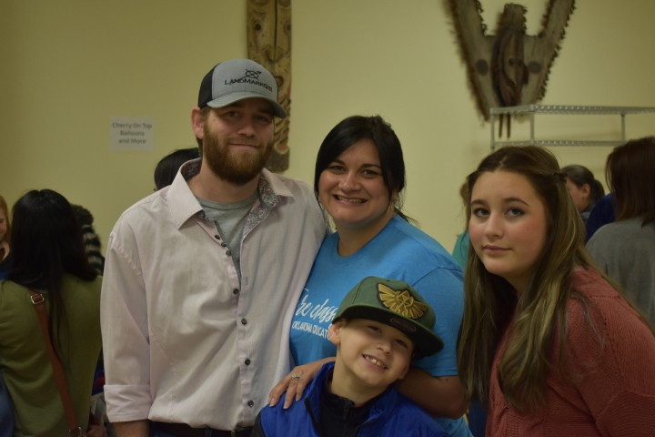
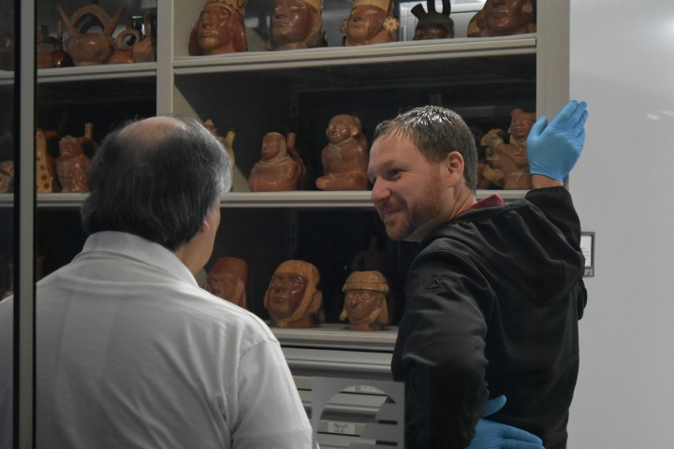
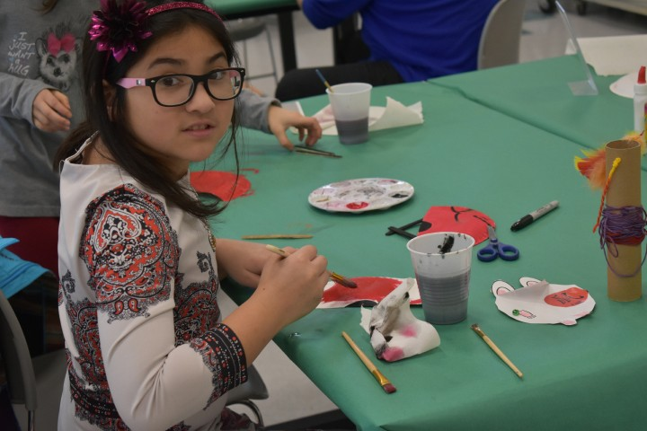
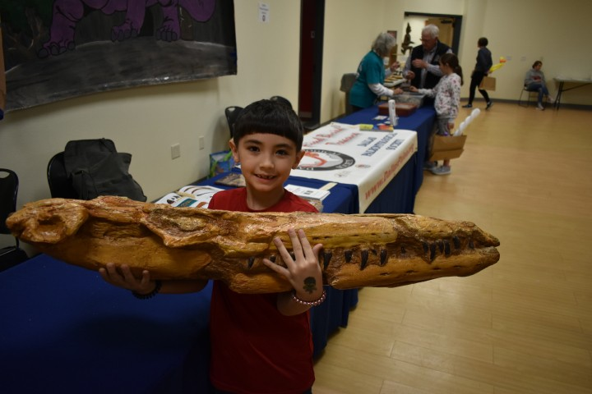
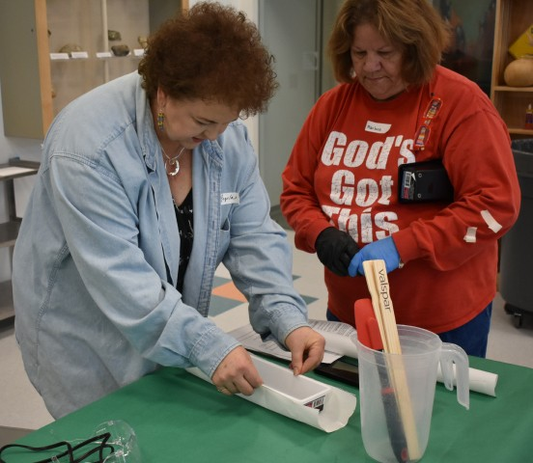




8
Corporate Partners (Business donors supporting the Museum’s free admission policy and other programs)
Quintus and Mary H. Herron Corporate Circle: Coca Cola Bottling of Idabel, Girls Gone Wine, Herron Family Tree Farm, International Paper Foundation, Newcomb Architects and Engineers
Corporate Leaders: Arvest Bank, Bailey Discount Building Supply (De Queen, AR), Bob Terry Insurance & Financial Services, Inc., Choctaw Electric Cooperative, Robbins RV + Motorsports, Tom Ellis-Attorney at Law
Corporate Partners: All Smiles Dental, Complete Care Medical Supply Inc., D and M Chipping, Dominance Industries/ Pan-Pacific Products, Edward Jones, Inc. (Broken Bow), Edward Jones, Inc. (Idabel), First State Bank, Hill Nursing Home, Hometown Rental, Idabel Lions Club, Idabel National Bank, McCurtain Daily Gazette, My Doctor Pediatrics and Urgent Care, Water House of Idabel, Vojai’s Winery, Weeks Insurance
Museum Life

Slide 10









9
Recent Acquisitions (January- March, 2020)
Gifts to the Collections
Female Effigy
Sculpture,
Untitled Painting, ca. 2000, Jack To Baahe
Gene (Navajo 1953-2016, )
Gift of
R. Weiss
Paintings (2): Inlet Cottage in HS 43, signed Bordin (John Bordin, American, 20th centu- ry), and an untitled work by Jack To’Baahe Gene (Navajo, 1953-2013); four-paneled room screens (2) of lacquered, painted and stone inlaid wood (“Straits” Chinese, early 20th century); ceramic sculpture (2) including horse and rider figure (Chinese, 3rd century BC) and seated figure of Mesoamerican wind god Ehecatl (Veracruz, Mexico, ca. 500); stone torso, probably from sculpture of Hindu goddess Lakshmi (Khmer [Cambodia], 11th - 13th centuries) Gift of R. Weiss (AZ)
Carved wood figure (Conibo-Shipibo peoples [Peru], 20th century); an oil on canvas painting Still Life with Acoma Pottery Jar by Ralph Dwight Ayer (American, 1909 – 1985); Ocumicho ceramic sculpture “Diablito Musicians in Bandstand” (Michoacan, Mexico) Gift of Janet Herron and Gamaliel Leyva (AZ)
ca. 11th-13th centuries (Khmer, Cambodia); Gift of R. Weiss
Still Life with Acoma Pottery Jar, Ralph Dwight Ayer (American, 1909-1985); Gift of Janet Herron and Gama- liel Leyva
Contemporary, hand-made cane, duct flute by Choctaw flautist and flute-maker Presley Byington. It is based upon the 11th - 12th century Breckenridge Flute found at the Breckenridge Bluff Shelter site in northwestern Arkansas in 1932.
Gift of the artist (OK)
Basket (Hopi, ca. 1900); hand-carved pair of dolls, signed Jim Kewanwyte- wa, 1943 (Hopi, active 1910 - 1966), painted ceramic jar with applied lizards by Juanita Arquero (Cochiti Pueblo, b. 1906); embroidered cotton dance kilt, ca. 1940s, (Cochiti Pueblo); pictorial rug, ca. 1980, signed “I J” (Isabel John, Navajo, 1933- 2004)
Gift of Dr. Frederick W. Lange (CA)
Cotton-linen “shaman’s-bag” decorated with beadwork faces and cowrie shells (Yoruba peoples, Nigeria, late 20th century
Gift of Dr. Alvin and Carmelita Turner (OK)
Group (11) of mates burilados (carved and decorated gourds), (Peru, 20th century) Gift of Dr. Robert and Pamela Brooks (OK)
Flute, Presley Byington (Choctaw
b. 1965); Gift of the Artist
Basket (Hopi, ca 1900); Gift of Frederick W. Lange
Museum Purchases
Shaman’s Bag, late Decorated Gourds, (Peru, 20th 20th Century, (Yoruba Century); Gift of Dr. Robert and peoples,Nigeria); Gift of Pamela Brooks (OK)
Dr. Alvin and Carmelita Turner (OK)
Miniature, woven horsehair basket (ca. 1980) by Rosalee Vavages (Tohono O’Odham [Papago], Arizo- na)
Small, silver sculpture (2): “Mantis with attached stone-cabochon” and “Corn stalk” by Jeff “Pink Eye” Storey
Corn Stalk, Jeff “Pink Eye”
Horsehair Basket, ca. 1980, Rosalee Vavages, (Tohono O’Odham) (AZ)
(Cherokee, b. 1946)
Storey, (Cherokee, b. 1946)

Slide 11
Museum of the Red River Building Fund Contributions 2016 – 2019
Lead Donors
Don and Mary Etta Herron Quintus H. Herron Trust
Sponsors
Ed and Cindy Fulmer
Janet Herron and Gamaliel Leyva
Benefactors
R.Q. “Pete” and Katie Herron Natalie and Buck Hill Charitable Gift Fund The Ronald and Maxine Linde Foundation
Ben Pickard/Pickard Gallery
Patrons
Suzannah M. Herron, Henry Moy, Julia M. and Forrest Sewell, Vickie and Scott Smith
Supporters
Jeanette and Greg Bohanan, Dr. Robert and Pamela Brooks, Lindsey Campbell, Bruce and Sheryl Delp, Faith and Jack Dulaney, Daniel and Christine Eck, William E. Gentry,
Tom and Jane Harding, Kyle and Katie Jones, Kama and Greg Koontz,
Michael and Lana McElroy, George H McGough, Chris and Rudy Michalek, Jack Moy, Carolynn Neal, Jim Newcomb and Tobin Newcomb, Bob and Judy Petre, John and Ida Ramsey,
Javier and Irma Reto-Viteri, Don and Nelda Shaw, Taylor and Becky Shaw,
Ron and Doris Smithee, Bob and Robin Terry, Billie Tomlinson, Cheryln Townsend, Terry and Michelle F. Walker, Dian Jordan Werhane, Carolyn and Eddie White;
Bob Terry Insurance and Financial Services, Don Shaw- Attorney, Edward Jones, Inc (Idabel),
Girls Gone Wine, Lambert Plumbing/Lambert Family, MAW, Michael S. McElroy Insurance, Quality Rock, Inc., Rotary Club of Idabel
Sustainers
Dr. Gleny and Charles Beach, Linda J. Bell, Dr. Kenneth Carpenter and Yvonne Wilson, Mike and Linda DeBerry, Leora and Mehdy Douraghy, Robbie and Dolphus Farley,
Pattie Janeway James, Sam and Dolly Johnson, Tina and Dr. Bruce King, Betty Ramsey,
Mark Ross, Timmi Ross, Lewis and Karla Schwartz, Mr. and Mrs. Larry C. Shaffer,
John and Barty Shipp Family, Lewis and Mayor Tina Foshee Thomas, Daniel and Katie Vick, Bill and Sharon White, David and Carlene White;
Broken Bow Lions Club, Dr. Lewis M. Stiles Memorial, Idabel Kiwanis Club,
Idabel Lions Club, McCurtain County Bar Association, Tom Ellis- Attorney at Law
Contributors
Frank and Jeanne Acker, Anonymous (3), Francine and Michael Bray, Victoria Michalek Craig Family, George Ann and Dr. Chester C. Danehower,
Rev. Charles and Jan Darby, Bill Denyer, Don and Peggy Dugan, Christine and Jim Eastep, Kenneth and Debbie Farley, Walt and Melinda Frey, Sally Gettys,
Kay Hobson, Edna and Norman Ikeda, Sandra Jackson,
Doris and Don Leatherwood, Carl LeForce, David Lundahl, John and Pat Malin, Brad Morse, Nam Tranh and Dinh Hung Nguyen, Lloyd W. Page,, Dane and Lynn Pollei,,
Stephen and Stephanie Ratcliff, Senator Joseph and Kimberlee Silk, Jeff and Elaine Smith, Dr. Lewis Stiles, Dr. Roslyn Walker, Rev. J. Edson and Jean C. Way, Sallie A. Webb; Judy’s Wholesale Furniture, McElroy Insurance Agency (Tulsa),
Donors
Lavetta Angelley, Virginia L. Bower, Dr. Alan and Cynthia Bryant, Ai-ling Chen,
William and Christina Eastep, Carolyn and Ron Engel-Wilson, Nicklaus Fulmer,
Brian Hendershot and Courtney Woods, David and Joanne Ho, Sherron Mitchell, Bob Norris, Doris Perkins,
Donald and Mary Ann Ray, M.C. Teel and Richard B. Sale
Herron Foundation, Inc. Idabel Museum Society, Inc.

Slide 12



Herron Foundation Board of Directors
Daniel W. Eck; David White; Donald Herron; Janet Herron; Richard Q. Herron; John Ramsey; Terry Walker; Sallie Webb, Mayor Craig Young (ex-officio)
Idabel Museum Society Board of Directors
Located in Idabel, Oklahoma, the Museum of the Red River is the largest cultural institution in a 150-mile radius. Its mission is to preserve and celebrate the world’s artistic heritage, while emphasizing the contributions made by native American groups. Its exhibition program includes temporary and permanent displays, most using objects drawn from its collections. The Museum also installs off-site exhibits throughout Southeast Oklahoma.
Dr. Robert Brooks; Lindsey Campbell; Dr. Bruce King; Carolynn Neal; JudyPetre; John Ramsey;TerryWalker
It offers dozens of educational programs each year, often in partnership with local organizations. It also houses a Public Reference Library and Research Library, which contain over 6000 volumes and printed materials illustrating cultural history. Hands- on, interactive learning opportunities are available year-round in the Holland and Sallie Webb Family Learning Center.
Museum of the Red River Staff
Donita Jacobs & Glenna Minter Museum Assistants; Hannah McNutt, Learning Center Coordinator; Henry Moy, The Quintus H. Herron Director; Katy Smith, Head of Programs; Vickie Smith, Business Manager; Stephen Ratcliff, Head of Communications; Daniel Vick, The Mary H. Herron Keeper of Collections
The Museum neither solicits nor accepts government funding. It is supported by earned and investment income and the ongoing support of individuals and organizations. Admission to the Museum is free, thanks to its Corporate Partners. To keep up with the latest Museum news, visit www.museumoftheredriver.org.
Idabel Museum Society, Inc 812 E. Lincoln Road
Idabel, OK 74745
Return Service Requested
Open 10 AM to 5 PM Tuesday through Saturday and 10 AM to 3 PM on Sunday.
Closed Mondays and national holidays. Admission is free.

